Slide 1

Music Recommendation System through facial expression Using CNN
ADITYA ENGINEERING COLLEGE(A)
Batch No : 02
Under the Guidance of
Dr.P.Udayakumar
Professor (CSE)
Department of CSE
Aditya Engineering College (A)
Presented By
CH.Govindaraju (19A91A0575)
S.V.V.Satyanarayana (19A91A05B9)
SK.Amreen (19A91A05C1)

Slide 2
Contents
Abstract
Introduction
1.1 Problem Statement
1.2 Aim & Objective of Project
1.3 Existing system
1.4 Proposed system and Advantages
1.5 Literature Survey Comparison Table
2.Requirement Analysis (SRS/HRS)
3.Architecture
4.Technology/Algorithm Used

Slide 3
ABSTRACT
Human emotion plays a vital role in recent times. Emotion is based on human feelings which can be both expressed or not. Emotion expresses the human’s individual behavior which can be in different forms. Extraction of the emotion states humans individual state of behavior. The objective of this project is to extract feature from human face and detect emotion and to play music according to the emotion detected. In this project, developing a prototype to recommend dynamic music recommendation system based on human emotions is our main aspect. Based on each human listening pattern, the songs for each emotion are trained. Our projected system concentrates on identifying the human feelings for development of a mood-based music player using computer vision and machine learning techniques. Some steps like face detection using webcam, facial landmark extraction, facial expression detection, with that connecting to a music player are going to be followed. For experimental results, Haar cascade algorithm and Computer vision for emotion detection and music recommendation.

Slide 4
INTRODUCTION
PROBLEM STATEMENT
Music listeners have a tough time creating and segregating the playlist manually when they have hundreds of songs. It is also difficult to keep track of all the songs: sometimes songs that are added and never used, wasting a lot of device memory, and forcing the user to find and delete songs manually. Users must manually select songs every time based on interest and mood. User’s also have difficulty to reorganize and playing music when play-style varies. Machine Learning concept which involves facial scanning and feature tracking to determine the user’s mood and based on it gives a personalized playlist.

Slide 5
AIM & OBJECTIVE
Aim:
To implement a Music system that recommends songs based on the facial expression.
Objective:
Haar Cascade is a machine learning algorithm to categorize objects in a captured image. It is used for object detection. The cascade classifier has different stages of collection which resembles from weak learners. These weak classifiers are the simplest form classifiers that have a name called boosting. If the label ranges in positive state, then it goes to the next stage showing the result..

Slide 6
CNN :
In previous papers they got high accuracy for all facial expressions except anger and neutral. Because it is difficult to distinguish between anger and neutral for the model while training the image dataset. If we consider the already proposed systems, they are showing around 29% accuracy for anger and neutral expressions. The most used dataset is FER2013. The algorithm is CNN (Convolution Neural Network) only for the training of facial image dataset but the problem is while training the dataset the model is unable to identify which is anger or which is neutral and another limitation is some algorithms are not working for multiclass SVM.

Slide 7
PROPOSED SYSTEM:
There are seven emotions that a human being can express on their face they are anger, disgust, fear, happy, sad, surprise. This project is working on detection of facial expression of a person and based on that respective music will be played.
To overcome the problems of the existing system this model is going to propose a set of folders for happy, sad, disgust, anger, neutral, fear, surprise. The entire dataset will be divided into training and testing, validation sets and for the integration of music each emotion music will be classified before. When the facial expression dataset is tested it will give emotion of the person as expression and that output will be integrated with input of music recommendation system and it will play the song accordingly.

Slide 8
SYSTEM REQUIREMENTS
Hardware Requirements:
Windows 10
RAM-8 GB
Storage-512 SSD
Software Requirements:
Splash Screen Demo
Dynamic Permissions
Emotion API
Music Recommendation System
Youtube API

Slide 9
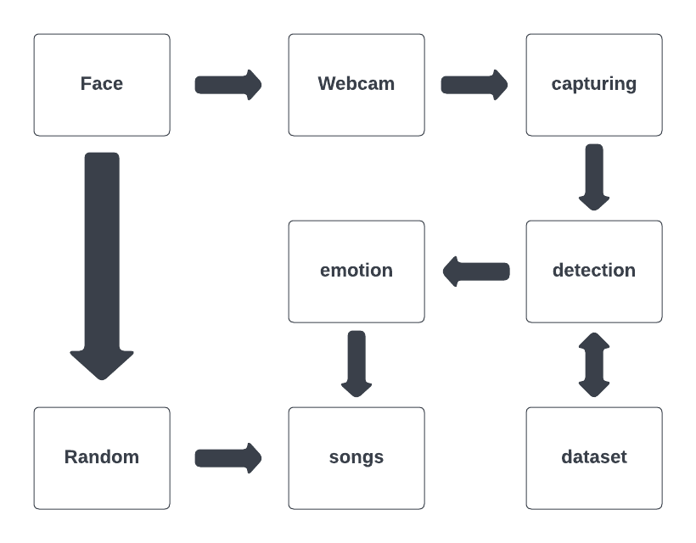
Project Flow /Architecture

Slide 10

TECHNOLOGY/ALGORITHM USED
Aditya Engineering College(A)
TECHNOLOGY: Deep Learning
ALGORITHM:
Convolutional Neural Network.
Haar Cascade Algorithm.

Slide 11
CONCLUSION
Emotions are one of the fascinating features of the human mind. Music is an equally extraordinary characteristic. Understanding the special interaction between the two may take us closer to understanding the fundamental nature of both. Music can boost memory, reduce anxiety and depression, and help you work out more effectively. A simple system is proposed here for the music recommendation using face emotion recognition. It suggests music by extracting different facial emotions of a person: Happy, anger, sad, neutral, fear and surprise. In this model cascade classifier is used to identify faces in a real time image. CNN is used to extract features for music recommendation based on emotion recognition. By determining the user’s emotion, the proposed system provided the user with a playlist that contains music matches with the detected emotion. The application is created in the cheapest possible way. Music recommendation system based on emotion detection will reduce the efforts of users in creating and managing playlists.

Slide 12
FUTURE SCOPE
Apart from recommending the music depending on the Facial expression these algorithms may be extended such that they divert the present sad, angry mood to an usual mood.

Slide 13
Literature Survey
[1] Shalini, Shantha K., et al. "Facial Emotion Based System using computer vision and machine learning techniques." Turkish Journal of Computer and Mathematics Education 12.2 (2021): 912-917.
This paper explains automatic face recognition system. This explains 3 sessions, 1. Face detection, 2. Feature Extraction and 3. Expression recognition.
They proposed AAM technique for facial feature extractions like extracting eye, eyebrows, mouth, lips etc.
This paper analyses and proposed Bezier curve fitting. They used for extracting the facial features from the original facial input images and also they proposed to extract region of interest from the input facial images. First the input image color is adjusted to make it compatible for feature extraction process .
The classification algorithm OpenCV is used for training the input images for facial emotion detection.
The accuracy that this paper has given is 92%.

Slide 14
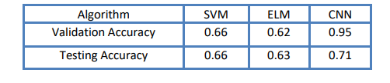
[2]. Music Recommendation Based on Face Emotion Recognition, journal of Informatics Electrical and Electronics Engineering (JIEEE), A2Z Journals, Volume: 2,2021
This paper uses support vector machine (SVM), extreme learning machine (ELM), and convolutional neural network
The dataset we used for emotion detection is from Kaggle Facial Expression Recognition. Dataset for the music player has been created from Bollywood Hindi songs.
The database is FER2013 which is split into two parts training and testing dataset. The training dataset consists of 24176 and the testing dataset contains 6043 images. There are 48x48 pixel grayscale images of faces in the dataset. Each image in FER-2013 is labeled as one of five emotions: happy, sad, angry, surprise, and neutral.
Implementation of facial emotion detection is performed using Convolutional Neural Network which gives approximately 95.14% of accuracy .

Slide 15
[3].EMOTION BASED MUSIC RECOMMENDATION SYSTEM, Dr.Sunil Bhutada, assistant Professor,2020 JETIR April 2020, Volume 7, Issue 4.
This image processing system is used for reducing the face space dimensions using the principal component analysis(PCA) method and then it applies fishers linear discriminant(FDL) or the LDA method to obtain the feature of the image characteristics.
This study uses two algorithms. They are Fisher Face algorithm, Haarcascade algorithm.
The steps are face capturing, face detection, emotion classification, Music recommendation.
The dataset is from kaggle which is FER2013 which contains huge amount of data.
The accuracy of this paper is around 89% which doesn’t give perfect results for angry emotion.

Slide 16
[4].EMOTION BASED MUSIC RECOMMENDATION SYSTEM H. Immanuel James1, J. James Anto Arnold2, J. Maria Masilla Ruban3, M. Tamilarasan4, R. Saranya5 , International Research Journal of Engineering and Technology (IRJET), Volume: 06 Issue: 03 | Mar 2019
The outcome of the project is split into 2 phases:
1. Develop a software to recognize user emotion based on facial expression using Python.
2. Integrate the python code into the web service and play the music based on the facial expression.
This paper uses SVM classifier, linear classifier for the training of the music system.
According to this paper linear classifier takes less time for the detection of facial features compared to SVM classifier.
The steps that were followed-
1. face detection
2. segmentation
3. performing SVM classification
4. emotion classification
5. Music recommendation
The efficiency of classifier is about 90-95%. so that even when there is any changes in the face due to environmental conditions the system can still identify the face and the emotion being expressed.

Slide 17
[5]. Mood based Music Recommendation System, International Journal of Engineering Research & Technology (IJERT) http://www.ijert.org ISSN: 2278-0181 IJERTV10IS060253 Published by : www.ijert.org Vol. 10 Issue 06, June-2021
The dataset used for training was obtained by combining FER 2013 dataset and MMA Facial Expression Recognition dataset from Kaggle. The FER 2013 dataset contained grayscale images of size 48x48 pixels. The MMA Facial Expression Recognition dataset had images of different specifications. Keras to train and test our model for seven classes - happy, angry, neutral, sad, surprise, fear and disgust.model trained it for 25 epochs and achieved an accuracy of approximately 75% for mood detection.
This paper classified the project into 4 modules they are Mood detection model, Music recommendation, Integration.
The project is developed as an application, which requires an user interface so they used Android Studio.
This trained model is an overfit model, which can sometimes lead to fluctuations in accurate detection. For example, the “disgust” mood is mostly classified as “angry” mood since the facial features (eyebrows, cheeks) are similar for both.
Trained model, having the accuracy of approximately 75%, able to detect seven moods accurately: anger, disgust, fear, happy, sad, surprise and neutral; and android application playing the music that would be suitable for the detected mood.

Slide 18
THANK YOU

